Slide 1
University of Basrah Al-zahraa medical college
Ministry of higher Education
and Scientific Research
The module: Mechanism of Disease
Session 6 / Lectures 2
Haemostasis and Thrombosis (II)
Module staff: Session 6
Dr. Sadiq K. Ali (Module leader)
Dr. Ihsan Mardan
Dr. Iman Abdul-Hadi Dr. Ghada Lateef
Dr. Wasan Mansur
Dr. Safa Asaad
Robbin’s Basic pathology 9th edition
Hoffbrands Essential Haematology 7th edition

Slide 2
Learning objectives:
Embolism;
Definition
Thromboembolism particularly DVT and pulmonary embolism
Other types of embolism
Anti-coagulant therapy;
Heparin
Warfarin
Prophylaxis in general
Other disorders of coagulation;
Haemophilia
Disseminated intravascular coagulation
Thrombocytopenia
Thrombophilia

Slide 3
Session 6
Lecture 2
LO:4
4- ANTI-COAGULANT THERAPY
Heparin:
Heparin is a glycosaminoglycan carbohydrate that contains variable repeats of a disaccharide unit.
It indirectly inhibits the serine protease coagulation factors by enhancing the action of antithrombin
Preparations are either unfractionated UFH(standard heparin) or fractionated (low‐molecular‐weight heparin [LMWH])e.g. dalteparin, enoxaparin. LMWH are better able to inhibit factor Xa than thrombin

Slide 4
LO:4
4- ANTI-COAGULANT THERAPY
Heparin:
Heparins are only active when administered parenterally.
The APTT is used for routine monitoring of therapeutic doses of UFH
Falls in platelet count (>50% compared with baseline) after 5 days of treatment should raise the possibility of heparin-induced thrombocytopenia (HIT)
Fondaparinux, a synthetic analog of the heparin, is an indirect factor Xa inhibitor. Given subcutaneously with a half‐life of 17 hours, it does not require laboratory monitoring.

Slide 5
LO:4
4- ANTI-COAGULANT THERAPY
Warfarin:
Warfarin is vitamin K antagonist, that inhibit synthesis of normal FII, FVII, FIX and FX and so result in anticoagulation.
Vitamin K is needed for the post-translational modification of the vitamin-K-dependent factors (II, VII, IX, X, protein C and protein S).
The anticoagulant effect varies between individuals and over time and needs to be monitored by the International Normalized Ratio (INR).

Slide 6
WARFARIN THERAPY: RECOMMENDED RANGES FOR INTERNATIONAL NORMALIZED RATIO FOR DIFFERENT CLINICAL INDICATIONS
LO:4

Slide 7
LO:4
4- ANTI-COAGULANT THERAPY
Warfarin: cont…
After warfarin is given, factor VII levels fall considerably within 24 hours but prothrombin has a longer plasma half‐life and only falls to 50% of normal at 3 days;
so if immediate anticoagulation is needed, heparin is given initially.

Slide 8
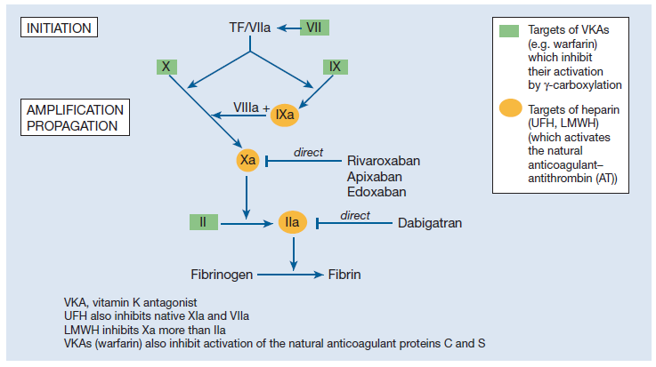
LO:4

Slide 9
LO:4
4- ANTI-COAGULANT THERAPY
Prophylaxis in general:
The decision as to whether to continue anticoagulant treatment indefinitely after a first proximal DVT or PE is dependent on the risk of recurrence without continued treatment and the perceived risk of bleeding on anticoagulation.
Long-term anticoagulation is usually given after recurrent unprovoked VTE.
For patients who receive long-term anticoagulation the risk–benefit ratio of continued treatment should be reassessed at regular intervals.

Slide 10
LO:4
4- ANTI-COAGULANT THERAPY
Prophylaxis in general: cont…
Following an episode of venous thrombosis, patients are 40 times more likely to suffer an event in the future than patients who have not previously suffered from venous thrombosis.
Patients with VTE provoked by surgery have an annualized recurrence rate of <1%. Patients with VTE provoked by a non-surgical factor have an annualized risk of 4% and patients with unprovoked VTE have an annualized event rate of 7%.

Slide 11
Suggested duration of anticoagulation
LO:4

Slide 12
LO:5
5- Other disorders of coagulation
Haemophilia:
Haemophilia A (factor VIII deficiency): It is the most common of the hereditary clotting factor deficiencies.
Haemophilia B (Christmas disease, factor IX deficiency): The incidence is one‐fifth that of haemophilia A.
The inheritance is sex‐linked but up to one‐third of patients have no family history and these cases result from recent mutation.

Slide 13
Haemophilia A: clinical severity
LO:5

Slide 14
LO:5
5- Other disorders of coagulation
Haemophilia: cont…
The characteristic bleeding pattern of haemophilia, which is both delayed after trauma and much prolonged.
Replacement by intravenous infusion of the deficient factor can normalize the haemostatic mechanism.
Recurrent painful haemarthroses and muscle haematomas dominate the clinical course of severely affected patients and, if inadequately treated, lead to progressive joint deformity and disability

Slide 15
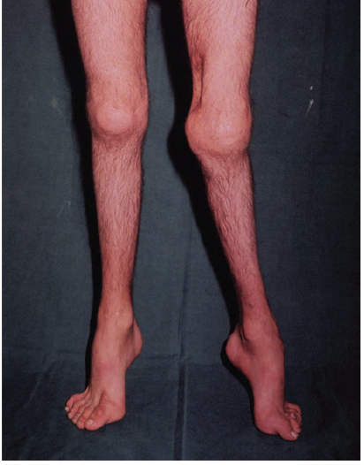
LO:5
Haemophilia A showing severe disability of the left Knee

Slide 16
LO:5
5- Other disorders of coagulation
Disseminated intravascular coagulation:
Widespread inappropriate intravascular deposition of fibrin with consumption of coagulation factors and platelets occurs as a consequence of many disorders that release procoagulant material into the circulation or cause widespread endothelial damage or platelet aggregation.

Slide 17
LO:5
5- Other disorders of coagulation
Disseminated intravascular coagulation: cont…
It may be associated with a fulminant haemorrhagic or thrombotic syndrome with organ dysfunction or run a less severe and more chronic course. The main clinical presentation is with bleeding but 5–10% of patients manifest thrombotic lesions.

Slide 18
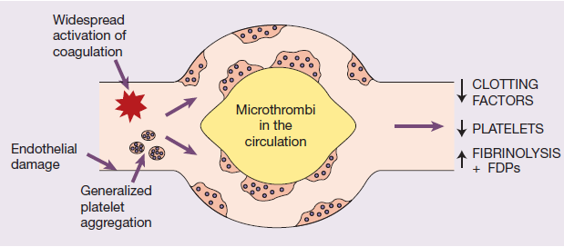
LO:5
Disseminated intravascular coagulation: cont…
The key event underlying DIC is increased activity of thrombin in the circulation that overwhelms its normal rate of removal by natural anticoagulants.
The pathogenesis of disseminated intravascular coagulation and the changes in clotting factors, platelets and fibrin degradation products (FDPs) that occur in this syndrome

Slide 19
LO:5
5- Other disorders of coagulation
Thrombocytopenia:
Thrombocytopenia defines a subnormal number of platelets in the circulating blood.
It has a wide range of causes including:
(i) failure of platelet production from a congenital cause, drugs or viral infection or a general bone marrow failure;
(ii) increased consumption of platelets. This may be acute or chronic autoimmune, drug‐induced, caused by disseminated intravascular coagulation or thrombotic thrombocytopenic purpura.

Slide 20
LO:5
5- Other disorders of coagulation
Thrombophilia:
There is no internationally accepted definition of thrombophilia. The term is sometimes used to describe disorders of haemostasis detected in the laboratory that appear to predispose to venous thrombosis.
A clinical definition of heritable thrombophilia describes an inherited tendency for venous thrombosis, i.e. deep vein thrombosis (DVT) with or without associated pulmonary embolus (PE).

Slide 21
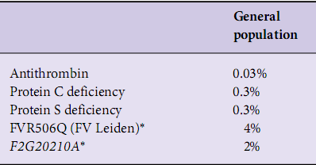
LO:5
5- Other disorders of coagulation
Thrombophilia: cont…
Prevalence of heritable thrombophilias shown to be associated with at least a two fold increased risk of venous thrombosis in patients and controls

